Slide 1
The Autonomic Nervous System

Slide 2
The efferent nervous system has two components:
  the somatic and
  the autonomic.
These two systems differ in a number of ways but are chiefly distinguished by the types of effector organs they innervate and the types of functions they control.

Slide 3
Neural Control of Involuntary Effectors
Autonomic nervous system (ANS):
  Innervates organs whose functions are not usually under voluntary control.
  Effectors include cardiac and smooth muscles and glands.
    Effectors are part of visceral organs and blood vessels.

Slide 4
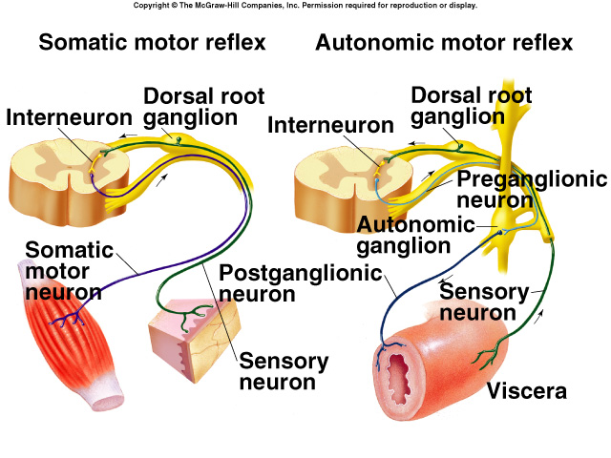
Autonomic Neurons
2 neurons in the efferent pathway.
1st neuron has its cell body in gray matter of brain or spinal cord.
  Preganglionic neuron.
Synapses with 2nd neuron within an autonomic ganglion.
  Postganglionic neuron.
Autonomic ganglion has axon which extends to synapse with target tissue.

Slide 5
Autonomic Neurons (continued)
Preganglionic autonomic fibers originate in midbrain, hindbrain, and upper thoracic to 4th sacral levels of the spinal cord.
Autonomic ganglia are located in the head, neck, and abdomen.
Presynaptic neuron is myelinated and postsynaptic neuron is unmyelinated.
Autonomic nerves release NT that may be stimulatory or inhibitory.

Slide 6
Visceral Effector Organs
Involuntary effectors are somewhat independent of their innervation.
  Smooth muscles maintain resting tone in absence of nerve stimulation.
    Denervation hypersensitivity:
      Damage to autonomic nerve makes its target tissue more sensitive than normal to stimulating agents.
  Cardiac and many smooth muscles can contract rhythmically in absence of nerve stimulation.

Slide 7
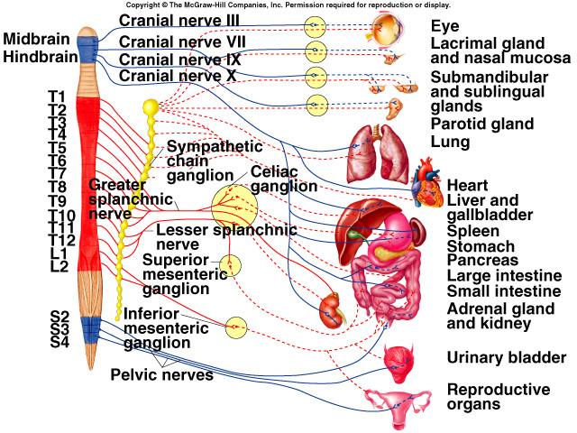
Divisions of the ANS
Sympathetic nervous system and para-sympathetic nervous system:
  Both have preganglionic neurons that originate in CNS.
  Both have postganglionic neurons that originate outside of the CNS in ganglia.

Slide 8
SYMPATHETIC NERVOUS SYSTEM
The overall function of the sympathetic nervous system is to mobilize the body for activity.
In the extreme, if a person is exposed to a stressful situation, the sympathetic nervous system is activated with a response known as "fight or flight," which includes increased arterial pressure, increased blood flow to active muscles, increased metabolic rate, increased blood glucose concentration, and increased mental activity and alertness.
Although this response, per se, is rarely employed, the sympathetic nervous system operates continuously to modulate the functions of many organ systems, such as heart, blood vessels, gastrointestinal tract, bronchi, and sweat glands.

Slide 9
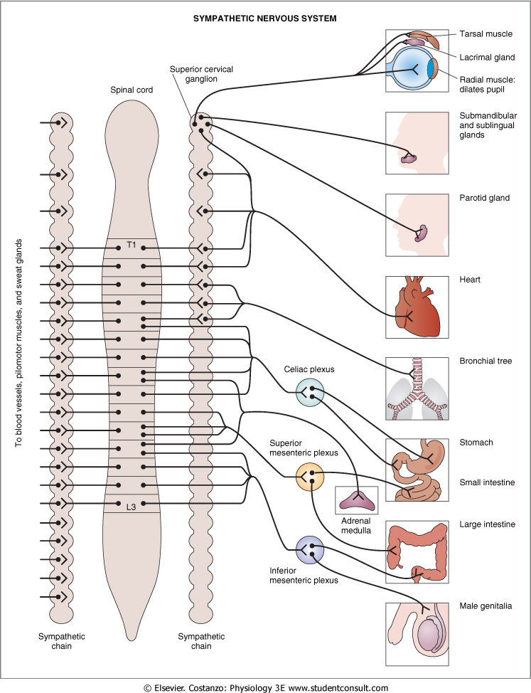
Sympathetic Division
Myelinated preganglionic fibers exit spinal cord in ventral roots from T1 to L2 levels.
Most sympathetic nerve fibers separate from somatic motor fibers and synapse with postganglionic neurons within paravertebral ganglia.
  Ganglia within each row are interconnected, forming a chain of ganglia that parallels spinal cord to synapse with postganglionic neurons.

Slide 10
Sympathetic Division
Divergence:
  Preganglionic fibers branch to synapse with # of postganglionic neurons.
Convergence:
  Postganglionic neuron receives synaptic input from large # of preganglionic fibers.

Slide 11
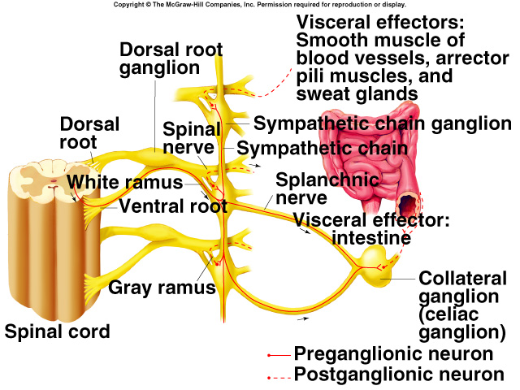
Sympathetic Division (continued)
Mass activation:
  Divergence and convergence cause the SNS to be activated as a unit.
Axons of postganglionic neurons are unmyelinated to the effector organ.

Slide 12
Adrenal Glands
Adrenal medulla secretes epinephrine (Epi) and norepinephrine (NE) when stimulated by the sympathetic nervous system.
Modified sympathetic ganglion:
  Its cells are derived form the same embryonic tissue that forms postganglionic sympathetic neurons.
Sympathoadrenal system:
  Stimulated by mass activation of the sympathetic nervous system.
  Innervated by preganglionic sympathetic fibers.

Slide 13
Parasympathetic Division
Preganglionic fibers originate in midbrain, medulla, pons; and in the 2-4 sacral levels of the spinal column.
Preganglionic fibers synapse in terminal ganglia located next to or within organs innervated.
Most parasympathetic fibers do not travel within spinal nerves.
  Do not innervate blood vessels, sweat glands, and arrector pili muscles.

Slide 14
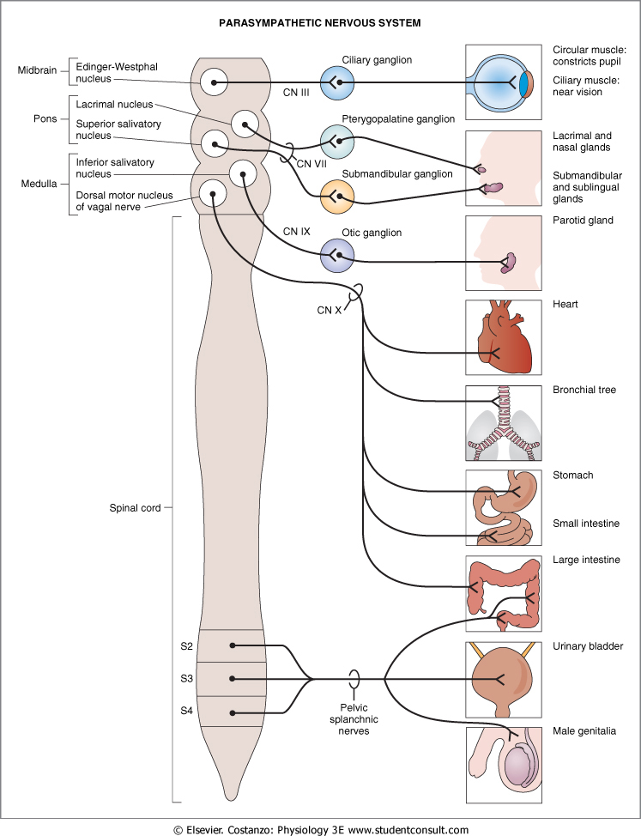
Parasympathetic Division (continued)
4 of the 12 pairs of cranial nerves (III, VII, X, IX) contain preganglionic parasympathetic fibers.
III, VII, IX synapse in ganglia located in the head.
X synapses in terminal ganglia located in widespread regions of the body.

Slide 15
Parasympathetic Division (continued)
Vagus (X):
  Innervates heart, lungs esophagus, stomach, pancreas, liver, small intestine and upper half of the large intestine.
Preganglionic fibers from the sacral level innervate the lower half of large intestine, the rectum, urinary and reproductive systems.

Slide 16
Sympathetic Effects
Fight or flight response.
Release of norepinephrine (NT) from postganglionic fibers and epinephrine (NT) from adrenal medulla.
Mass activation prepares for intense activity.
  Heart rate (HR) increases.
  Bronchioles dilate.
  Blood [glucose] increases.

Slide 17
Parasympathetic Effects
Normally not activated as a whole.
  Stimulation of separate parasympathetic nerves.
Release ACh as NT.
Relaxing effects:
  Decreases HR.
  Dilates visceral blood vessels.
  Increases digestive activity.

Slide 18
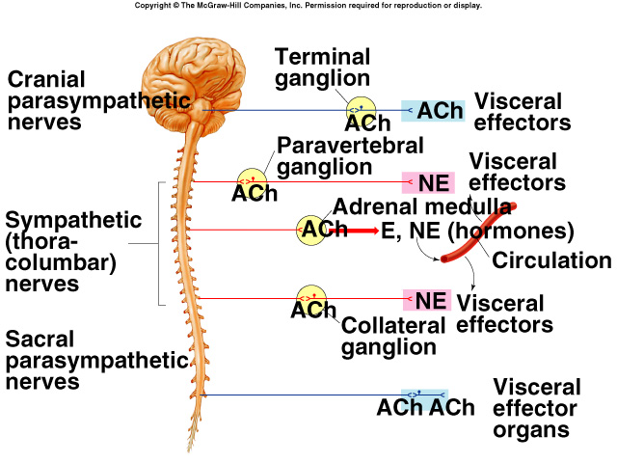
Adrenergic and Cholinergic Synaptic Transmission
ACh is NT for all preganglionic fibers of both sympathetic and parasympathetic nervous systems.
Transmission at these synapses is termed cholinergic:
  ACh is NT released by most postganglionic parasympathetic fibers at synapse with effector.

Slide 19
Axons of postganglionic neurons have numerous varicosities along the axon that contain NT.

Slide 20
(1) In the autonomic nervous system, the postganglionic neurons that innervate target tissues form diffuse, branching networks. Beads, or varicosities, line these branches and are the sites of neurotransmitter synthesis, storage, and release. The varicosities are therefore analogous to the presynaptic nerve terminals of the neuromuscular junction.
(2) There is overlap in the branching networks from different postganglionic neurons, such that target tissues may be innervated by many postganglionic neurons.
(3) In the autonomic nervous system, postsynaptic receptors are widely distributed on the target tissues, and there is no specialized region of receptors analogous to the motor end plate of skeletal muscle.

Slide 21
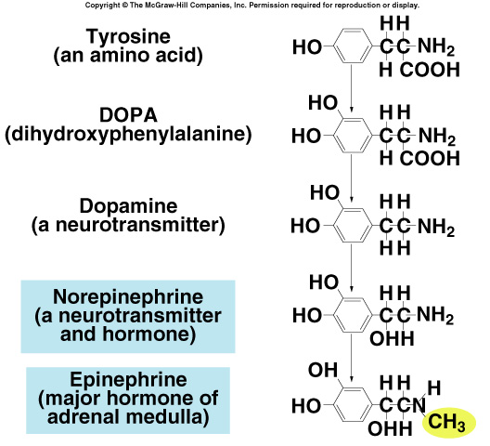
Adrenergic and Cholinergic Synaptic Transmission (continued)
Transmission at these synapses is called adrenergic:
  NT released by most postganglionic sympathetic nerve fibers is NE.
  Epi, released by the adrenal medulla is synthesized from the same precursor as NE.
Collectively called catecholamines.

Slide 22
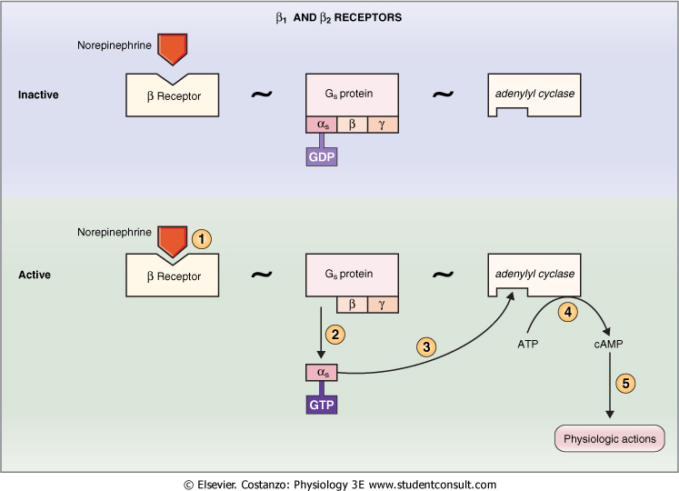
Responses to Adrenergic Stimulation
Beta adrenergic receptors:
  Produce their effects by stimulating production of cAMP.
  NE binds to receptor.
  G-protein dissociates into α subunit or βγ− complex.
  Depending upon tissue, either α subunit or βγ−complex produces the effects.
    Alpha subunit activates adenylate cyclase, producing cAMP.
      cAMP activates protein kinase, opening ion channels.

Slide 23
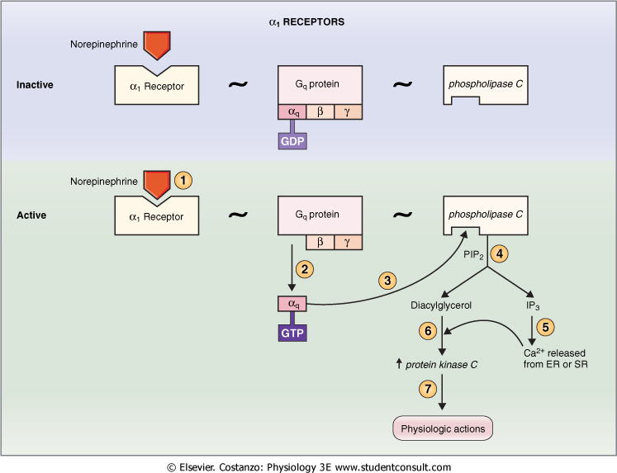
Responses to Adrenergic Stimulation (continued)
Alpha₁ adrenergic receptors:
  Produce their effects by the production of Ca²⁺.
  Epi binds to receptor.
  Ca²⁺ binds to calmodulin.
  Calmodulin activates protein kinase, modifying enzyme action.
Alpha₂ adrenergic receptors:
  Located on presynaptic terminal.
    Decreases release of NE.
      Negative feedback control.
  Located on postsynaptic membrane.
    When activated, produces vasoconstriction.

Slide 24
Responses to Adrenergic Stimulation (continued)
Has both excitatory and inhibitory effects.
Responses due to different membrane receptor proteins.
  α₁ : constricts visceral smooth muscles.
  α₂ : contraction of smooth muscle.
  β₁ : increases HR and force of contraction.
  β₂ : relaxes bronchial smooth muscles.
  β3: adipose tissue, function unknown.

Slide 25
Responses to Cholinergic Stimulation
All somatic motor neurons, all preganglionic and most postganglionic parasympathetic neurons are cholinergic.
  Release ACh as NT.
  Somatic motor neurons and all preganglionic autonomic neurons are excitatory.
  Postganglionic axons, may be excitatory or inhibitory.

Slide 26
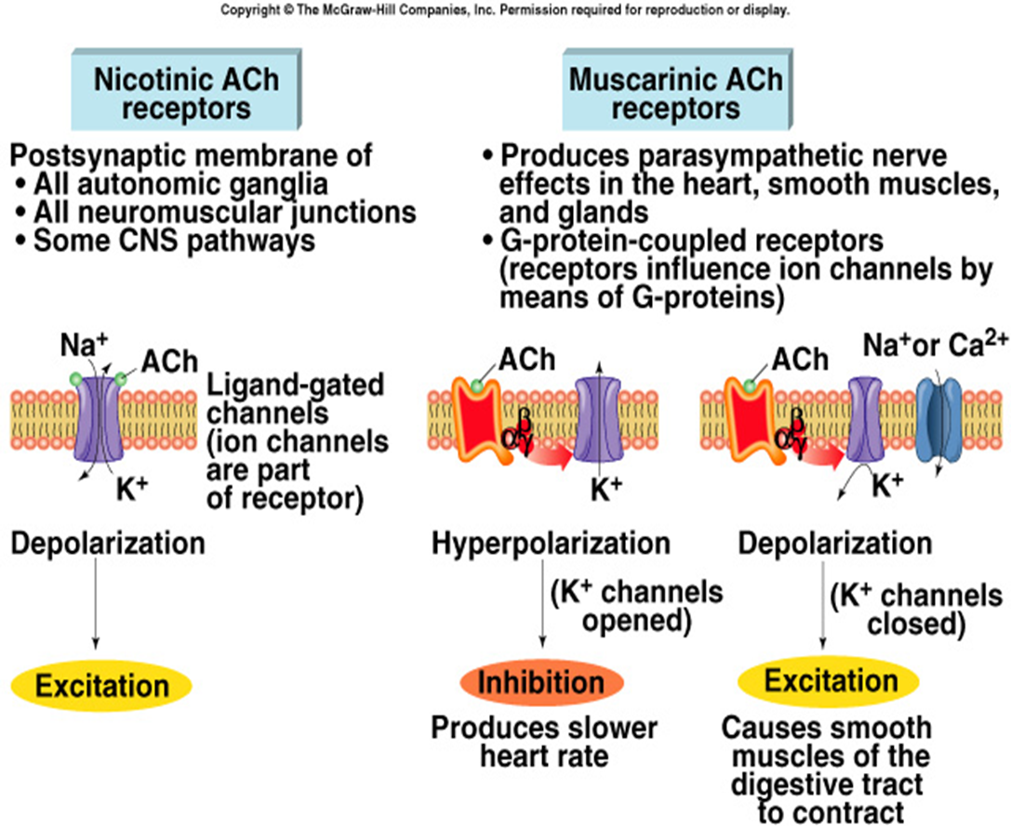
Responses to Cholinergic Stimulation
Muscarinic receptors:
  Ach binds to receptor.
  Requires the mediation of G-proteins.
  βγ-complex affects opening or closing a channel, or activating enzymes.

Slide 27
Responses to Cholinergic Stimulation (continued)
Nicotinic receptors (ligand-gated):
  ACh binds to 2 nicotinic receptor binding sites.
  Causes ion channel to open within the receptor protein.
    Opens a Na⁺ channel.
Always excitatory.

Slide 28
Other Autonomic NTs
Certain nonadrenergic, noncholinergic postganglionic autonomic axons produce their effects through other NTs.
  ATP.
  VIP.
  NO.

Slide 29
Organs With Dual Innervation
Most visceral organs receive dual innervation (innervation by both sympathetic and parasympathetic fibers).
Antagonistic effects:
  Sympathetic and parasympathetic fibers innervate the same cells.
    Actions counteract each other.
      Heart rate.
Complementary:
  Sympathetic and parasympathetic stimulation produces similar effects.
    Salivary gland secretion.
Cooperative:
  Sympathetic and parasympathetic stimulation produce different effects that work together to produce desired effect.
    Micturition.

Slide 30
Organs Without Dual Innervation
Regulation achieved by increasing or decreasing firing rate.
Adrenal medulla, arrector pili muscle, sweat glands, and most blood vessels receive only sympathetic innervation.
  Nonshivering thermogenesis.

Slide 31
Control of the ANS by Higher Brain Centers
Sensory input transmitted to brain centers that integrate information.
Can modify activity of preganglionic autonomic neurons.
Medulla:
  Most directly controls activity of autonomic system.
  Location of centers for control of cardiovascular, pulmonary, urinary, reproductive and digestive systems.
Hypothalamus:
  Regulates medulla.
Cerebral cortex and limbic system:
  Responsible for visceral responses that are characteristic of emotional states.

